Slide 1


PLANT DISEASE DETECTION
USING DEEP LEARNING
PANTULA ANANYA
STU679cee65a1d7a1738337893

Slide 2

Learning Objectives
Plant Disease Detection Using CNN
CNN (Convolutional Neural Network) helps detect plant diseases from leaf images by learning patterns like spots and colors.
Model classifies 38 diseases (e.g., Tomato Late Blight, Apple Black Rot).
What It Does:
Learns features from images
Predicts disease type automatically
Key Metrics:
Accuracy – Overall correctness
Precision & Recall – Quality of predictions
F1 Score – Balance of precision and recall
Applications:
Smart farming
Medical diagnosis
Self-driving tech
GOAL
Source :
www.freepik.com/

Slide 3
Tools and Technology used
Python
Main programming language used for coding and model development.
TensorFlow & Keras
Deep learning libraries used to build and train the CNN model for image classification.
OpenCV
Used for image processing and visualization tasks like reading and resizing images.
NumPy & Pandas
For data manipulation and numerical operations during preprocessing.
Matplotlib
To plot graphs and visualize model performance (accuracy/loss curves).
Google Colab
Cloud-based Jupyter notebook with free GPU support; used to run the entire project easily online .
Dataset (PlantVillage)
Contains images of plant leaves labeled with disease names (38 classes total). Used for training and testing the model.
https://drive.google.com/file/d/12OS3a0bLn1zDnhqv5KRRH_BfFml6gCVX/view?usp=sharing this is the link of the dataset which contains the details about the plant village.

Slide 4
Methodology
📁 Dataset Collection
Used the PlantVillage dataset with 38 plant leaf classes
🧹 Data Preprocessing
Resized and normalized images for uniform input
🧠 Model Building (CNN)
Built a CNN with convolution, pooling, and dense layers
📈 Model Training
the model and tuned it using validation data
🧪 Model Evaluation
Evaluated with accuracy, precision, and recall
🔍 Prediction
Tested the model on new images to identify disease
📊 Result Visualization
Plotted accuracy/loss graphs during training

Slide 5
Problem Statement:
"Every leaf tells a story — but what if we could listen before it’s too late?"
In the real world, millions of farmers struggle to detect plant diseases in time. A single undiagnosed infection can destroy entire harvests, disrupt food supply chains, and force the overuse of harmful pesticides. Visual identification by the human eye is slow, error-prone, and inaccessible to many rural communities without expert guidance.
This project tackles the problem by developing a deep learning-based image classification system that can accurately detect and identify plant diseases using leaf images. Farmers or agricultural experts can take a photo of a leaf, and the system will instantly identify whether it’s healthy or infected, and if infected, specify the disease.
🔧 Key Features:
Uses Convolutional Neural Networks (CNNs) for high-accuracy image recognition
Trained on a dataset of labeled plant leaf images across various crops and diseases
Provides real-time diagnosis using simple inputs like mobile photos
Helps reduce crop loss and dependency on expert intervention

Slide 6
Solution:
🧠 Smart Learning We taught a computer to recognize sick leaves by showing it thousands of plant images — like teaching a kid to spot what's wrong in a picture!
📸 Photo-Based Diagnosis Just snap a leaf photo, and our system tells you the disease in seconds. No guessing. No waiting.
💻 Behind the Scenes A CNN (Convolutional Neural Network) works like a super-powered microscope — it finds tiny patterns, spots, and colors to decide what disease is present.
🌍 Ready for the Real World It’s simple, fast, and works anywhere. Farmers, students, or anyone can use it with a phone or computer!
🌱 Tiny Idea, Big Impact
Our goal was simple: Make plant disease detection as easy as taking a selfie. 🤳
Git hub link for this project is:
https://github.com/Ananya-class/Plant-Disease-Detection-System

Slide 7
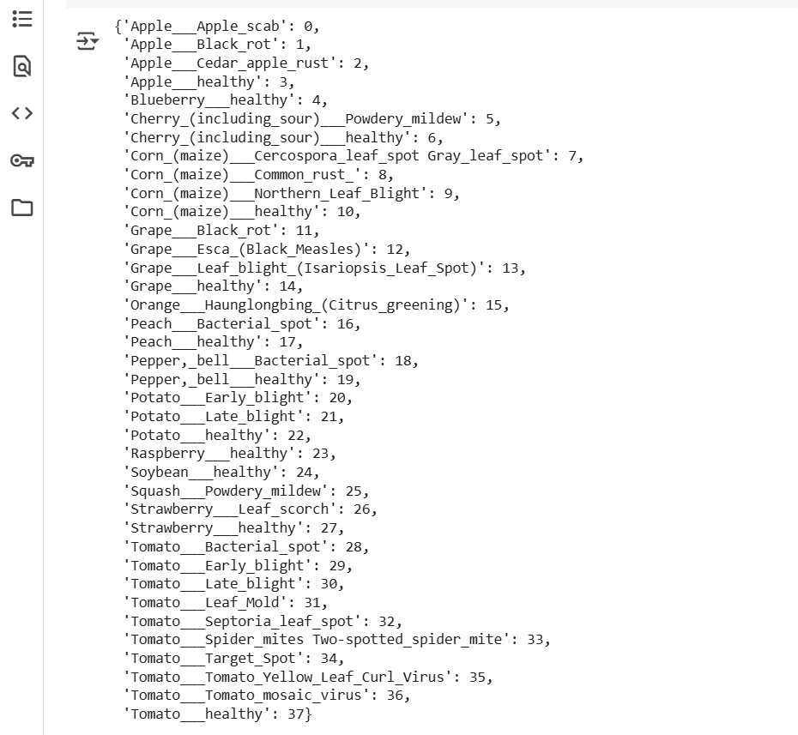
Screenshot of Output:

Slide 8
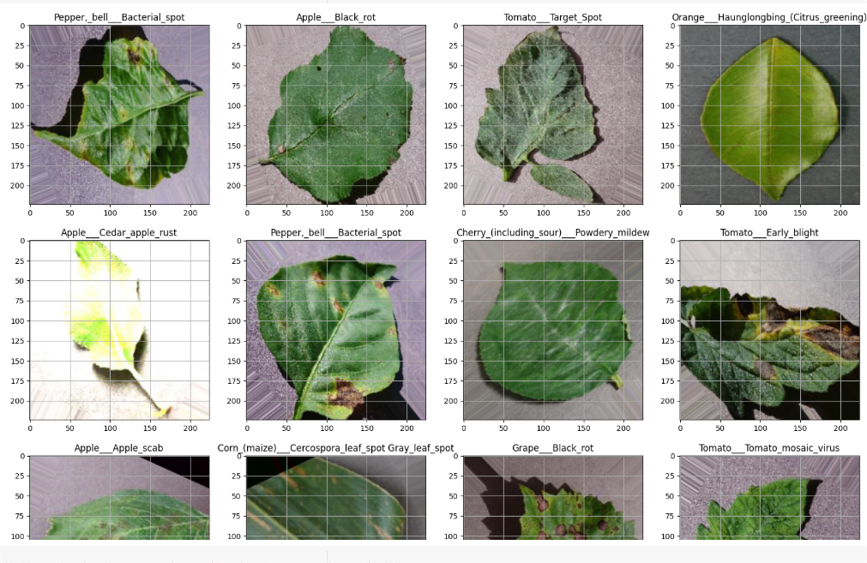
Screenshot of Output:

Slide 9
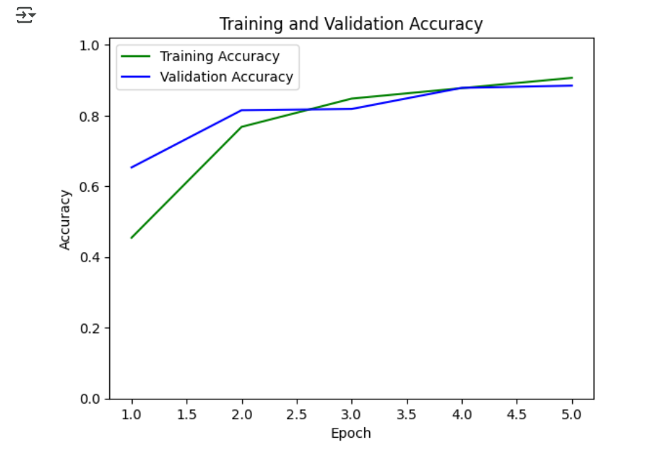
Screenshot of Output:

Slide 10
Conclusion:
🧠 Project Summary
We developed a CNN-based image classification system to detect plant diseases from leaf photos.
The CNN learns visual patterns like spots, color changes, and edges by passing the image through layers that extract features step by step.
Our model was trained to classify leaf images into multiple classes such as "Healthy", "Early Blight", "Leaf Mold", etc., achieving high accuracy and reliability.
🌱 Future Scope
📱Mobile & Web App Deployment
Turn the model into an app farmers can use in the field for instant results.
🌍 More Crop Varieties & Diseases
Expand the model to recognize more plant types (e.g., wheat, rice, cotton) and additional diseases.
🛰️ IoT & Drone Integration
Use drones or field cameras to capture leaf images in large farms automatically.
🎓 Self-Learning System
Create a feedback loop where new images improve the model, making it smarter over time.
⚙️ Generalization
Train on more diverse datasets (lighting, angles, backgrounds) to make the model work well in any real-world environment, not just lab conditions.

